Slide 1
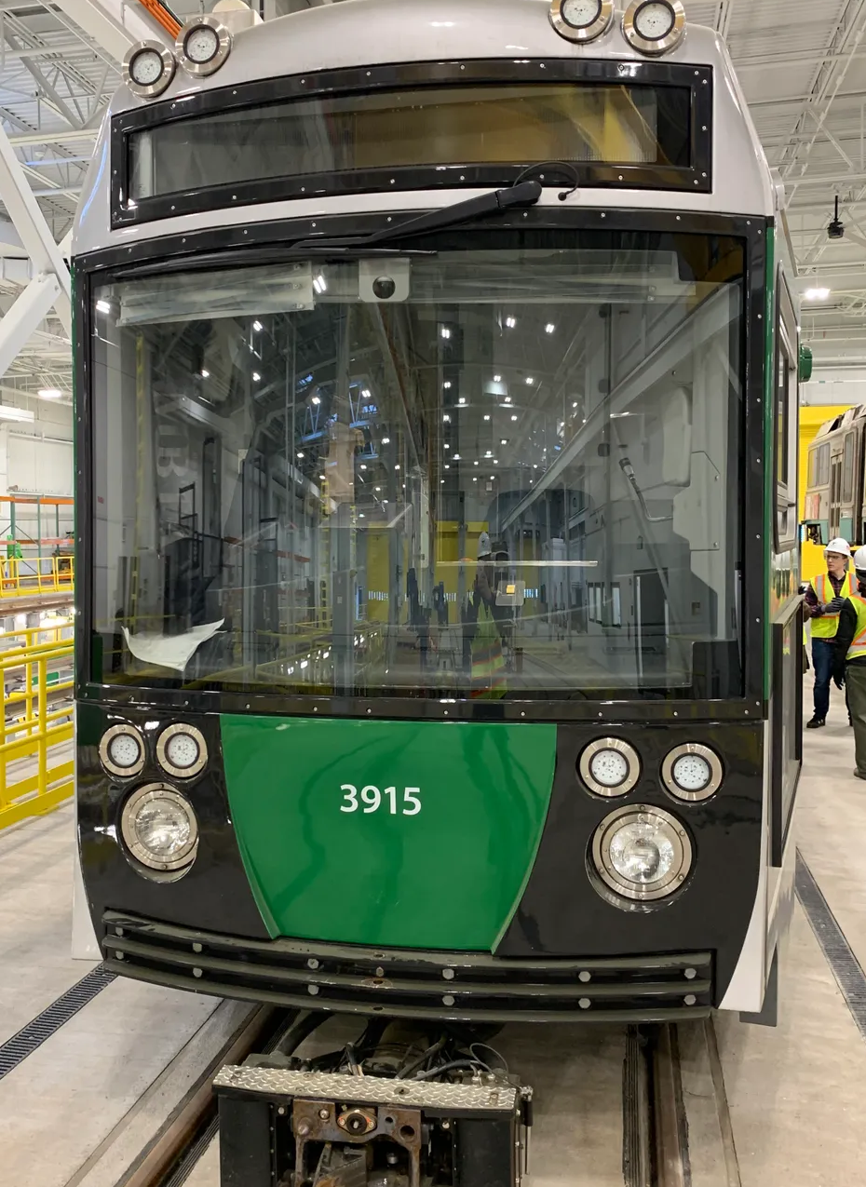
HEADWAY: Analyzing Consistency on the MBTA

Slide 2
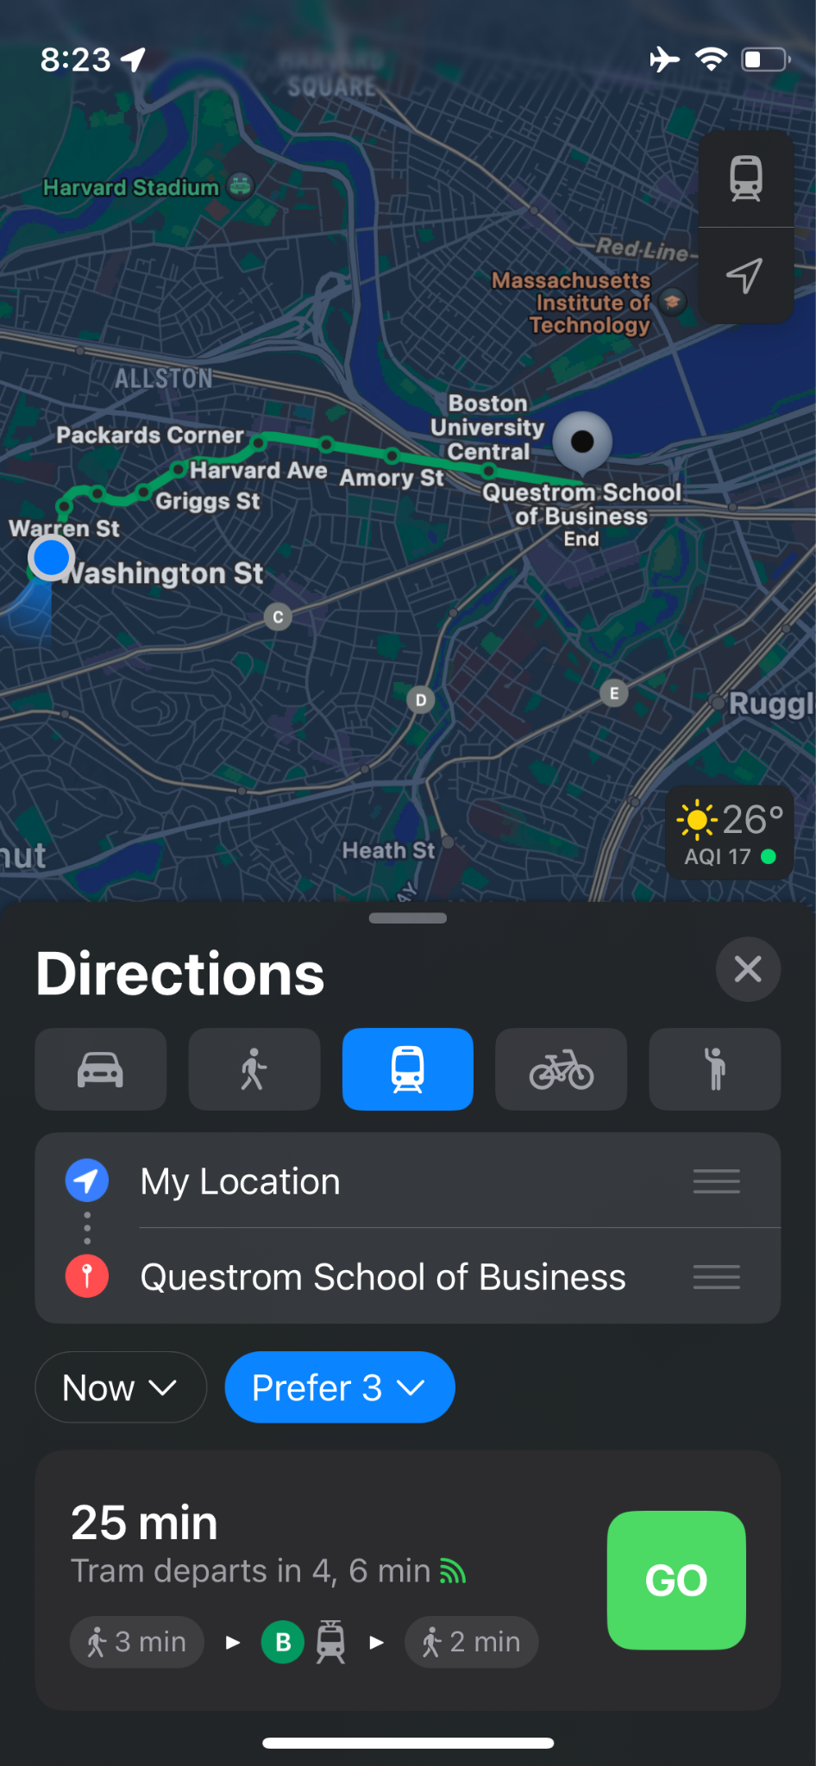

Slide 3
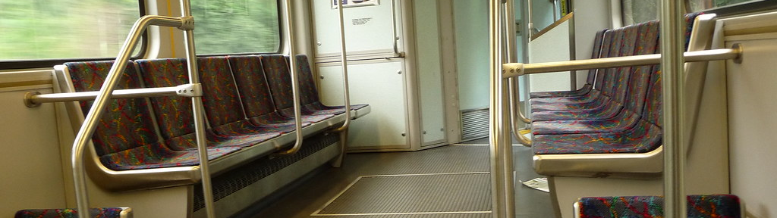
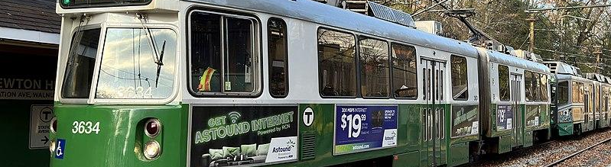
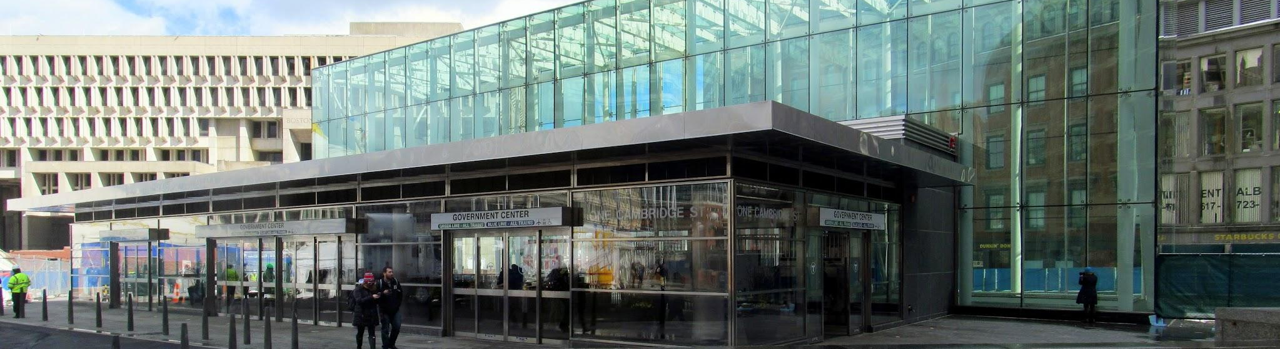
PURPOSE
Increasing Reliability
By making the MBTA’s service more consistent, they can potentially increase ridership.
Increase Revenue
By improving ridership, the MBTA can bring in more revenue.
Minimize Cost
The MBTA is estimated to have a budget deficit of $700 million by 2026. Any recommendations should strongly consider cost.

Slide 4
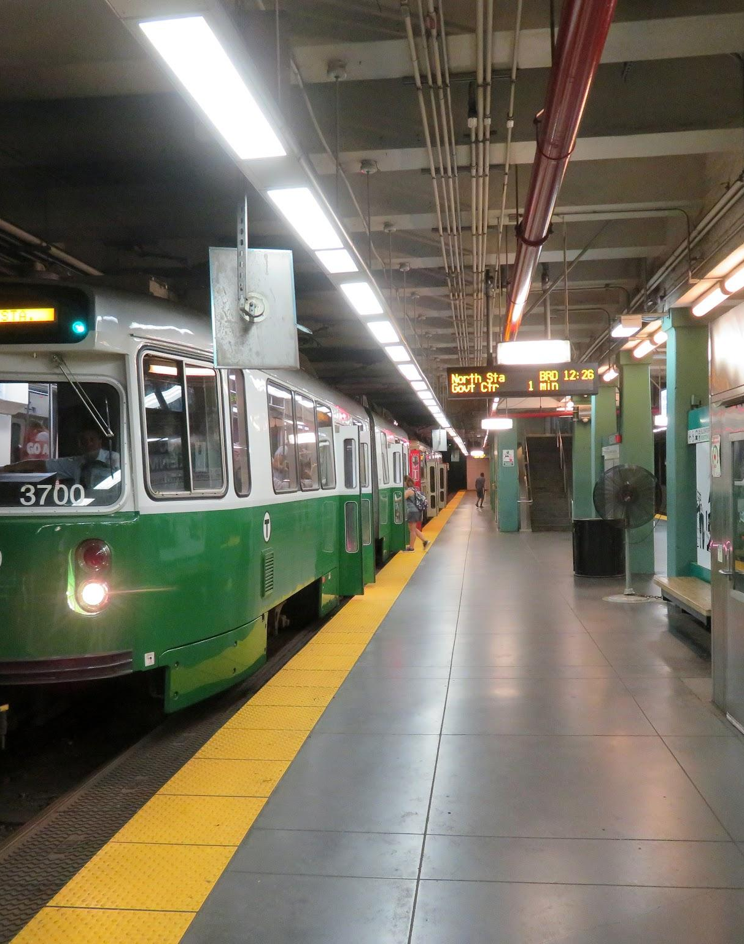
OUR DATA
The MBTA offers select datasets that they record publicly. We investigated their gated station entry data and headway data.

Slide 5
HEADWAY
Train 1
Amory Street
Headway is the amount of time or distance between two trains.
Headway
Train 2 left Amory Street 5 minutes ago.
So, Train 1 has 5 minutes of headway.
Train 2

Slide 6
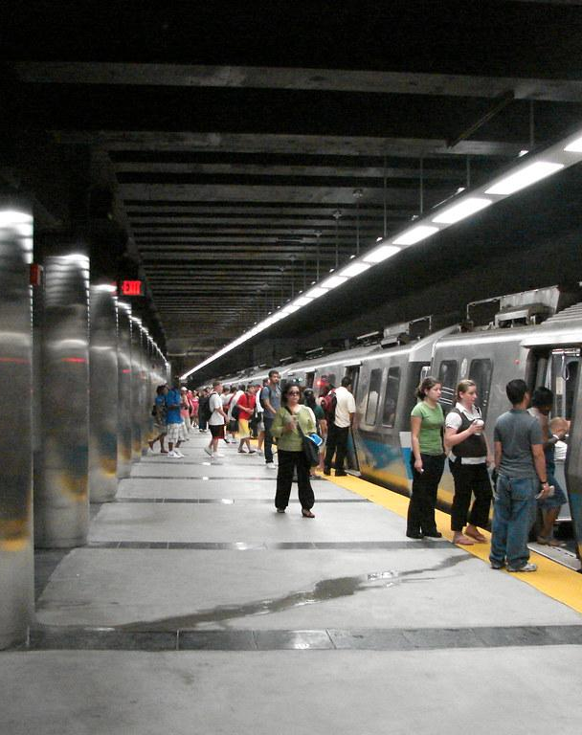
A OVERVIEW OF MBTA CONSISTENCY
https://public.tableau.com/app/profile/barrett.ratzlaff/viz/MBTAHeadwayDashboard/EDADashboard?publish=yes

Slide 7
PEOPLE NEED THE T
We found very little correlation between slower headway and station entries. People still rely on the MBTA’s service, despite it not being 100% reliable.

Slide 8
VARIABILITY
Washington Street
Headway: 5 minutes
Looking at the headway per stop only gives a snapshot of Green-B Line Service.
The headway changed by +2 minutes between stations. Why?
Warren Street
Headway: 7 minutes

Slide 9
NORMAL INTERSECTIONS
There are two different flows of traffic, and one is parallel with the trolley.

Slide 10
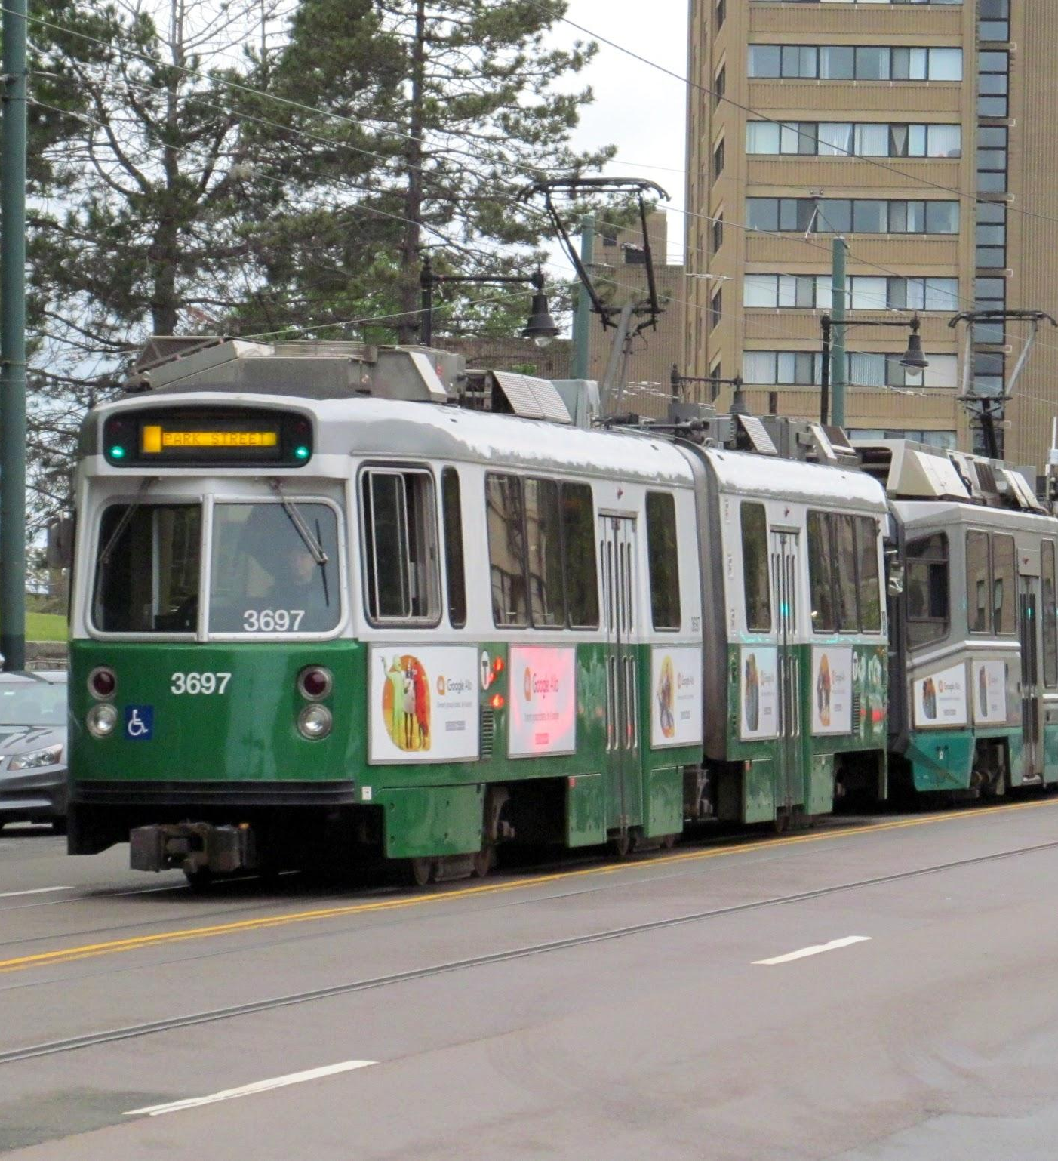
ABNORMAL INTERSECTIONS
Because the flow of traffic is complex at certain stations, some stops may experience a greater degree of randomness in headway.

Slide 11
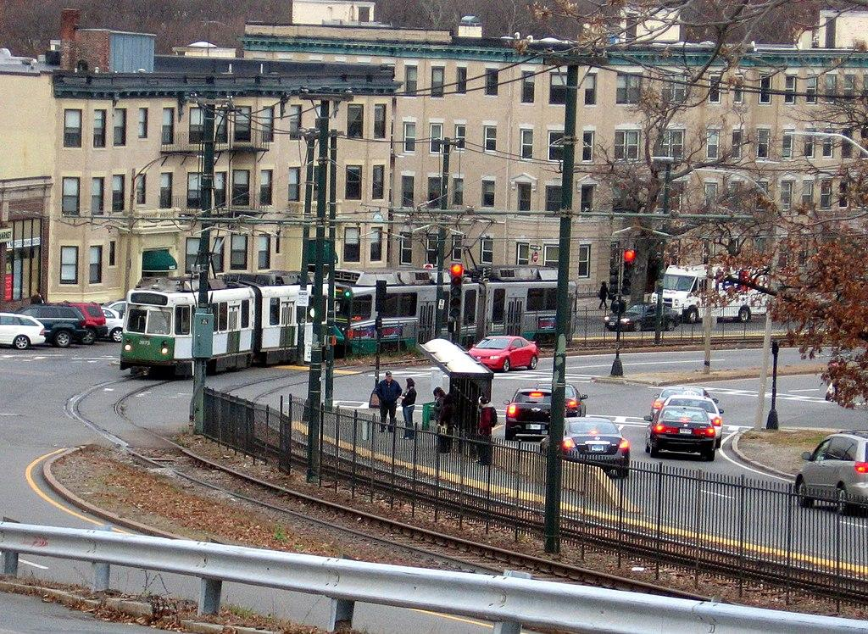
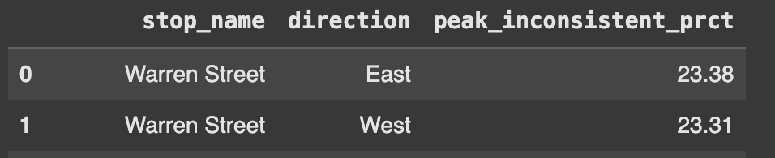
ABNORMAL INTERSECTIONS
At Warren Street, trains have a 15-20 second window to cross the street, with 90 seconds of wait time before the next window.
They also must go independently from other flows of traffic.

Slide 12
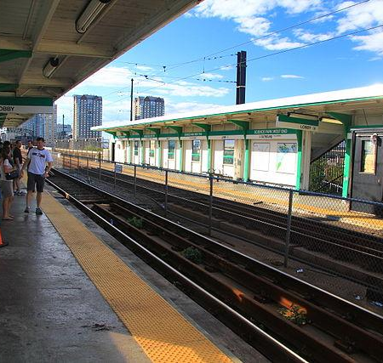
GREEN-B LINE
CONSISTENCY
https://public.tableau.com/app/profile/barrett.ratzlaff/viz/Green-BLineConsistencyDashboard/ConsistencyofGreenBLineServicein2024

Slide 13
Recommendations
Train Signal Priority (TSP)
Door operation
Gate Machine Establishment
Monthly Membership Promotion

Slide 14
Thank you!

